Slide 1
A Statistical Analysis of Heart Disease & Stroke
MATH 7343
TJ Gardner-Souza, Amanda Huang, Luc Ravenelle, Erik Wilder, and Muskan Yadav

Slide 2
Background
Investigated an open-source stroke dataset from Kaggle
Stroke is the second largest cause of death among people worldwide
The dataset hosts a sample of 5,111 patients of unknown origin or location
Study is observational in nature. Therefore, the outcome of this analysis will only show association and not make any causal conclusions
It contains 10 predictor variables (7 categorical and 3 numerical) and a binary variable indicating whether or not the patient had a stroke
Target Population: Global human population (all ages, with no distinct region specified)
Sampled Population: Those patients with data recorded (unclear, source of data is confidential)
Sample: 5,111 people
Parameter in question: Proportion of patients
who have experienced stroke
Notes:
Amanda

Slide 3
Dataset
Preparation
Null values in the predictor variables were replaced
Normalized the numerical data such as glucose, BMI, and age
Created ‘dummy’ variables from the categorical variables and up-sampled the minority class.
Notes:
Amanda

Slide 4
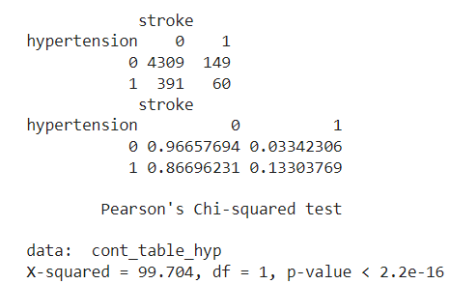
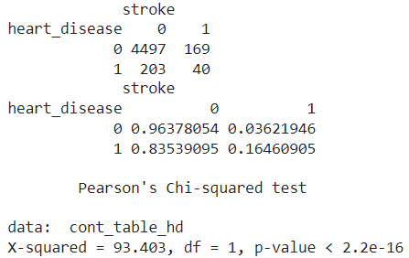
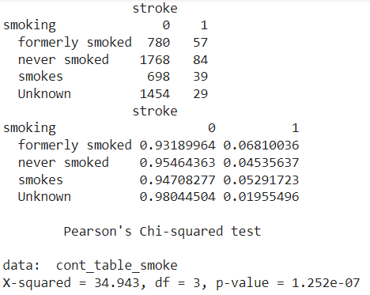
Data Analysis
Contingency Table Results
Null hypothesis: there is no relationship between the predictor variables and the target variable
Used contingency tables
p-value < 𝛼 = 0.05, reject the null hypothesis
Notes:
Amanda

Slide 5
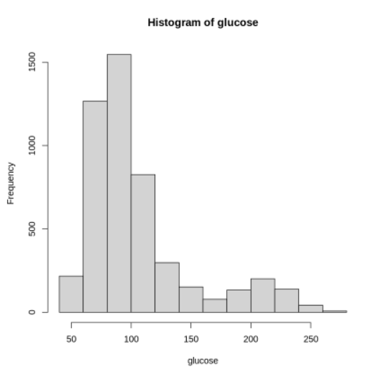
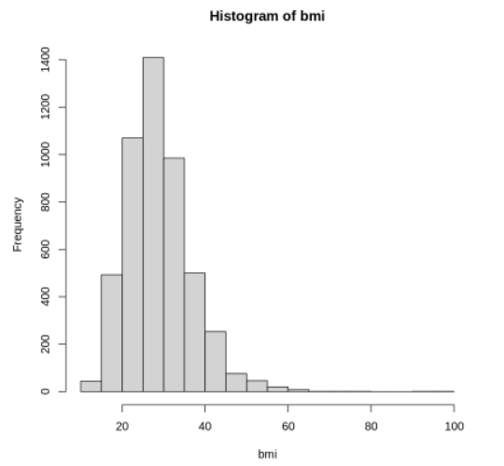
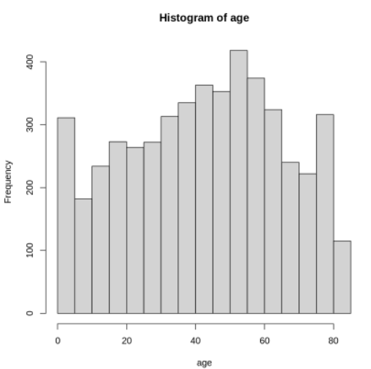
Tests on the Numerical Variables
Histograms were implemented to categorize the type of distribution
Histograms are not normally distributed. Thus, warranting the Wilcoxon rank-sum test.
The outputs of the histograms
Glucose
BMI
Age
Notes:
Muskan

Slide 6
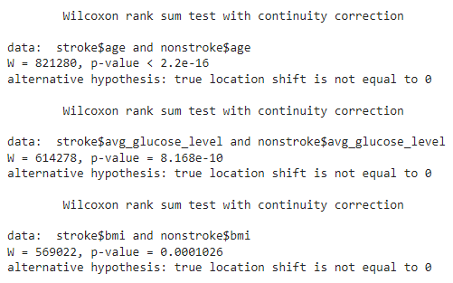
Wilcoxon rank-sum
At 𝛼 = 0.05, we reject the null hypothesis because 𝛼 is greater than the level of significance for all three tests
Thus, there is sufficient evidence to conclude that the medians of the two tested populations are not equal
Notes:
Muskan

Slide 7

Logistic Regression
For identifying a new patient as “at-risk” for having a stroke, we performed logistic regression
Split the data into 75% training and 25% testing data
Normalized numerical data
Placed categorical data into ‘dummy’ columns
Omitted ‘Formerly Smoked’ category
Prediction result of this model is pictured below:
Notes:
TJ

Slide 8
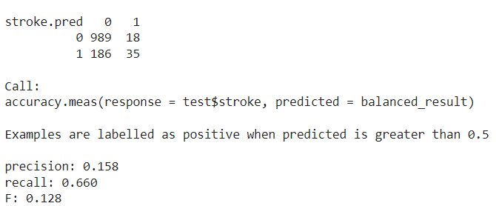
Second attempt
Employed an over-sampling technique to solve the issue of imbalance of stroke patients and non-stroke patients and performed another logistic regression
Results are in line with previous Chi-square and Wilcoxon tests
Classification results shown below have a precision of 0.158, that is 85% of positive classifications were incorrect
Recall is 0.660 implies classification of 66% of true positives correctly
Low f-score, suggests that this model does not perform well overall
Notes:
TJ

Slide 9
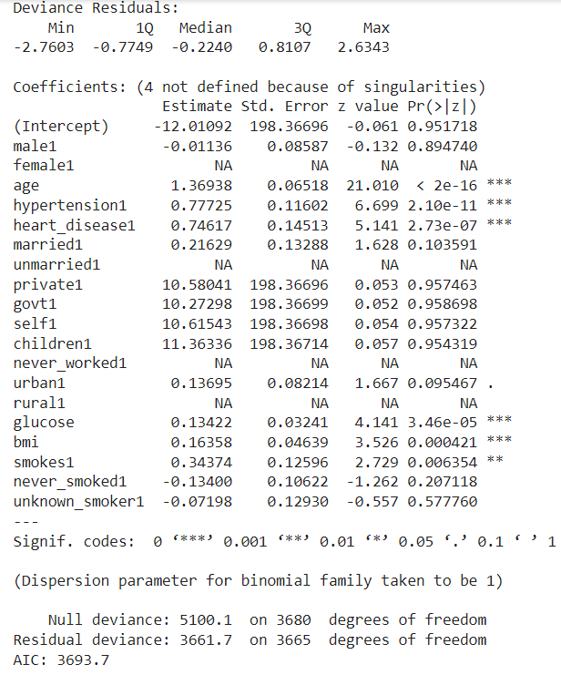
This logistic regression identifies six variables to be correlated with stroke
Notes:
TJ

Slide 10
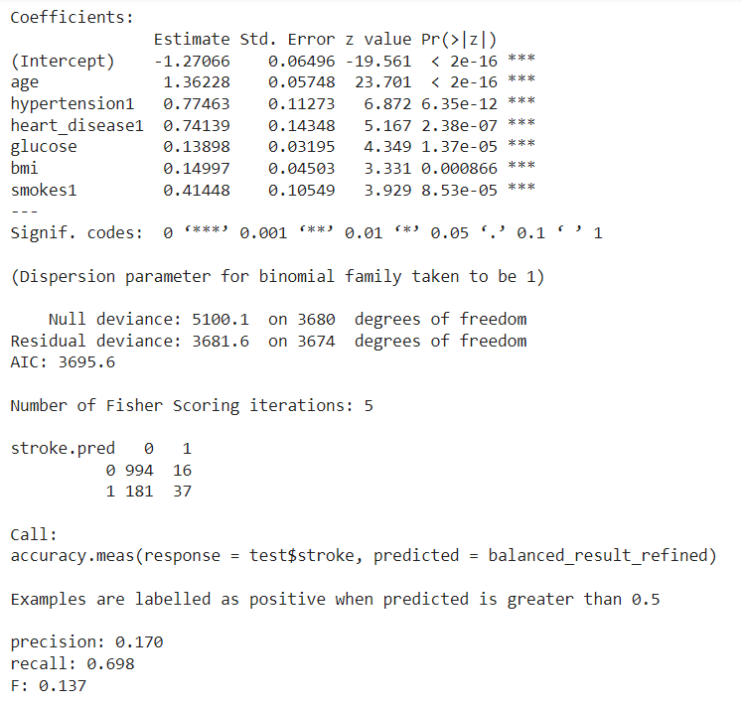
Third Attempt
Omitted variables that were not found to be significant.
Results from this model are as pictured below:
p- value < 𝛼 = 0.05. Hence all of them are correlated with stroke
Notes:
TJ

Slide 11
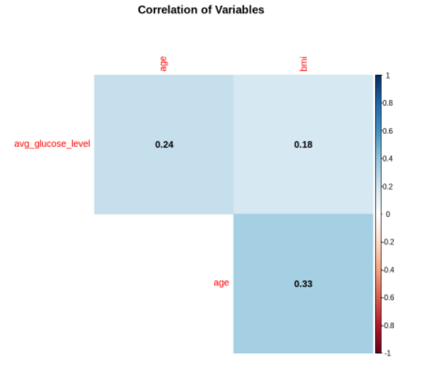
Correlation Plot
None of the numerical variables show a significantly high correlation with each other
Notes:
Erik

Slide 12
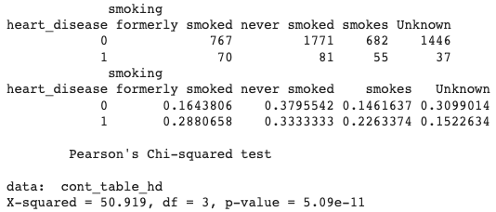
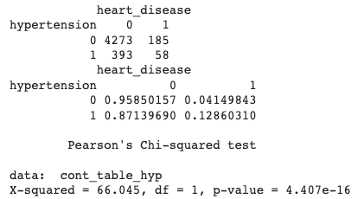
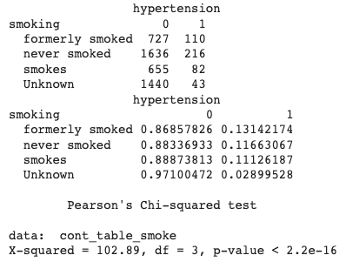
Chi-square tests
To test correlation among the categorical variables, performed a series of chi-square tests among them:
Sufficient evidence to suggest that a correlation exists amongst all of the categorical predictor variables.
Kept all numerical variables
Only selected the most significant categorical predictor value, that is hypertension
Notes:
Erik

Slide 13
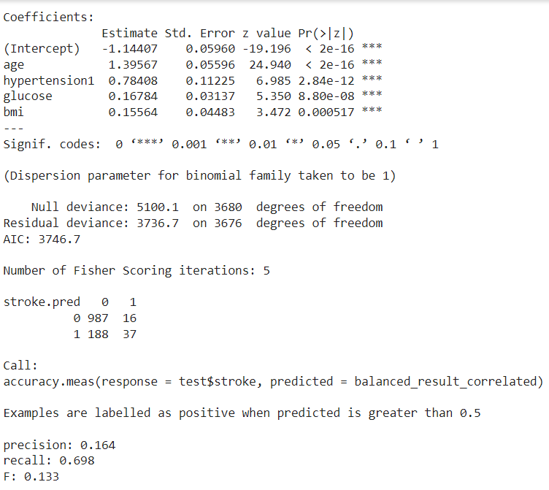
Final attempt
The results from the final model are as presented below:
16.4% of positive classifications were correct, and 70% of true positives were identified correctly.
F-score is 0.133, suggesting that this model does not generally perform well.
Notes:
Luc

Slide 14
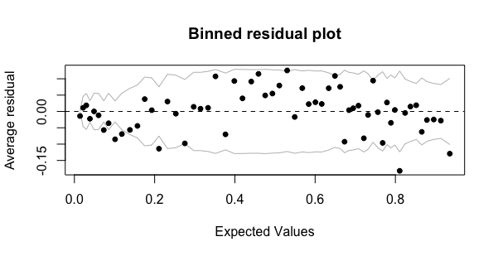
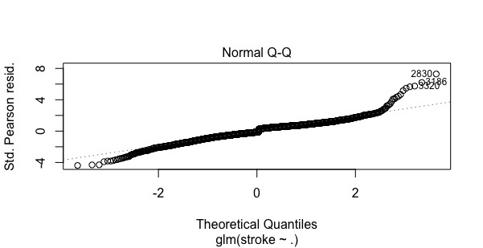
Residuals
An effective way to identify incorrect inferences in data and possible peculiarities
Residual is derived from the observed minus the fitted value
First image below is plotting the average residual vs. the average fitted value for each bin.
The model does well with positive residuals, but not negative ones.
The model is over predicting stroke
Notes:
Luc

Slide 15
Thank you!

